Slide 1
Photomicrographs of Plant Seeds
Strawberry
Permission to reproduce original photomicrographs used to make this collection may be obtained from
Dr. David O. Norris at
david.norris@colorado.edu

Slide 2
10X
25X
Strawberry seed
Notes:
S56. Strawberry seed [Fragaria chiloensis (L.) Mill]. The woodland strawberry is Fragaria vesca.

Slide 3
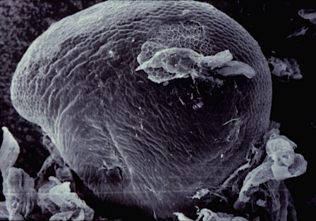
Notes:
S57. Strawberry seed [Fragaria chiloensis (L.) Mill]. SEM courtesy of Dr. Meredith A. Lane.

